Slide 2
PROCJENA BOLI
.

Slide 3
Razlozi za liječenje boli
Humanost u samom postupku
Etička, moralna i pravna obaveza
Neliječena bol uzrokuje ozljedu i patnju
Bol smanjuje aktivnost, apetit, spavanje i kvalitetu života
Bol dodatno oslabljuje ionako oslabljene pacijente

Slide 4
Ciljevi kontrole boli
Poboljšanje kvalitete života
Održavanje autonomije, dostojanstva, emocionalnog i spoznajnog kapaciteta
Kontrola depresije i anksioznosti u odnosu prema loše kontroliranoj boli
Očuvanje funkcija i rehabilitacijskog potencijala

Slide 5
BOL
Bolesnikov doživljaj boli je "zlatni standard " u procjeni boli
Liječnik mora prihvatiti bolesnikov doživljaj boli kao važan u anamnezi.

Slide 6
Bolne činjenice
Bol zahvaća više bolesnika nego DM, srčane bolesti i tumori zajedno
75 milijuna ljudu ima danas trajnu onesposovljavajuću bol, sljedećih 25 milijuna iskusi akutnu bol svake godine
Bol je glavni razlog zbog kojeg ljudi potraže zdravstvenu skrb, a samo 1 od 4 bolesnika je ispravno liječen
Preko 75% karcinomskih bolesnika iskusi srednje jaku do jaku bol; manje od pola ih je zbrinuto

Slide 7
FIZIOLOŠKI EFEKTI BOLI
Porast morbiditeta i mortaliteta
Neublažena bol uzrokuje stresni odgovor koji potiče kaskadu događaja
Povećanje kataboličkog odgovora; slabije cijeljenje rana, slabost, mišićno popuštanje

Slide 8
FIZIOLOŠKI EFEKTI BOLI
Negativne emocije: tjeskoba, strah, nevjerica i depresija
Gubitak sna
Ugroženost egzistencije: može voditi do suicidalnih misli
Smanjenje kvalitete života
Smanjena sposobnost savladavanja stresa

Slide 9
ČINJENICE I RAZMATRANJA U PROCJENI BOLI:
Načelno, cilj liječenja boli je sprečavanje i smanjenje boli, poboljšanje funkcije, poboljšanja raspoloženja i kvalitete spavanja, te predviđanje i liječenje nuspojava

Slide 10
ČINJENICE I RAZMATRANJA U PROCJENI BOLI:
Ciljevi liječenja boli nisu smanjenje doza lijekova na najmanju moguću mjeru
Doze koje bolesniku umanjuju bol dobar su argument za korištenje samo adekvatnih doza

Slide 11
Što uzrokuje bol u bolesnika sa karcinomom?
Bol može biti akutna, trajna ili intermitentna
Bol može biti nociceptivna, neuropatska ili mješovita
Usljed tumora
Vezana uz liječenje
Nevezana uz bolest
American Medical Association. Pain Management Part 4: Cancer Pain and End-of-Life Care, December 2003; p 6-9.
Notes:
Assumptions may be made that all cancer and cancer therapy causes pain, which is not the case. Knowledge of the causes of pain in the person with cancer will enable the health care professional to more effectively predict, preempt and treat pain.
Interaction: Build this slide. Have participants brainstorm potential causes of pain, citing specific examples.
Pain in the patient with cancer may be acute, persistent and/or intermittent and may have a variety of etiologies. Further complicating care, pain may be the result of nociceptive, neuropathic or mixed mechanisms. It is important that the source and type of pain be identified whenever possible. Pain as a result of tumor involvement may be secondary to space occupying lesions such as hepatic metastasis, destructive lesions such as bone metastasis, brain metastasis, tumor infiltration of nerves, pain associated with hypercalcemia, etc. Acute pain syndromes are commonly caused by diagnostic or therapeutic interventions as well as cancer itself. Persistent pain syndromes have a more complex taxonomy, related to the associated etiologies and pathophysiologies.¹⁻³
Acute pain associated with:
Diagnostic procedures – e.g. bone marrow biopsy, venipuncture, paracentesis
Surgery – e.g. incisional pain, mastectomy
Therapeutic procedures – e.g. pleurodesis, tumor embolization, nephrostomy insertion
Chemotherapy – e.g. mucositis, peripheral neuropathy (e.g. vincristine cisplatin, paclitaxel), bone pain from colony stimulating factors
Immunotherapy – e.g. arthralgia and myalgia from interferon and interleukin
Radiation therapy – e.g. mucositis, enteritis, proctocolitis, early onset brachial plexopathy
Tumor – e.g. vertebral collapse and other pathological fractures, acute obstruction of hollow viscus, headache
Infection – e.g. myalgia and arthralgia associated with sepsis, soft tissue inflammation¹⁻³
Persistent / chronic pain in patients with cancer associated with:
Tumor – e.g. bone metastases, paraneoplastic syndromes, neoplastic involvement of the viscera, radiculopathy, plexopathy
Radiation – e.g. osteonecrosis, lymphedema, abdominal pain, plexus fibrosis, myelopathy, tissue fibrosis
Chemotherapy – e.g. abdominal pain due to intraperitoneal infusion, polyneuropathies
Surgery – e.g. lymphedema, post mastectomy syndrome, post radical neck dissection syndrome, phantom limb pain¹⁻³
Oncologic Emergencies: Although beyond the scope of this presentation, healthcare professionals must be mindful of pain-related oncologic emergencies that require prompt diagnosis and treatment. Treatment should include analgesics as well as specific treatment of the oncologic emergency as clinically indicated. Oncologic emergencies most often associated with pain include bone fracture or impending fracture of weight-bearing bone, brain metastases, spinal cord compression/epidural metastases, leptomeningeal metastases and pain related to infection.^{1,3}
The incidence of pain related to treatment or an unrelated condition may be getting higher. More aggressive treatment options are becoming available and there is more use of combination therapy, both of which may increase the incidence of pain. In addition, people with an increased survival may be more likely to develop a persistent pain state.
It is also important to consider the incidence of persistent pain of a non malignant etiology and the likelihood that a cancer patient may have pain unrelated to their cancer. (Examples may include arthritis, spinal stenosis, diabetic neuropathy) This etiology does not diminish the impact or consequences of their pain in relation to their cancer.
References:
¹American Medical Association. Pain Management Module 10: Overview and Assessment of Cancer Pain. December 2005.
²American Medical Association. Pain Management Part 4: Cancer Pain and End-of-Life Care, December 2003; p 6-9.
³National Cancer Institute. Pain, modified 1/23/07; p 5-8. http://cancer.gov/cancerinfo/pdq/supportivecare/pain/healthprofessional Accessed 3/02/07.

Slide 12
Činioci koji utječu na težinu boli
Vrsta karcinoma
Faza bolesti
Terapija tumora
Prag boli
¹American Medical Association. Pain Management Module 10: Overview and Assessment of Cancer Pain. December 2005.
²National Cancer Institute. Pain, modified 1/23/07; p 5-8.
Notes:
Many factors may influence pain severity for any given patient, highlighting the need for a thorough understanding of the patient, their pain and their underlying disease.
Type of Cancer – not all cancers cause pain and not all people with a pain-associated diagnosis will experience pain to the same intensity, if at all. However, it is important to be mindful of the fact that pain prevalence rates have been estimated at 40-90% depending on the primary site of cancer.¹ Certain cancers are more likely to result in pain. Most cancer pain arises when a tumor presses on bone, nerves or body organs.^{2,3}
Common cancer pain presentations include, but are not limited to: bone metastasis from breast, lung, and prostate cancers and multiple myeloma; epidural spinal cord compression associated with breast, lung, prostate and renal cancer and multiple myeloma; cervical, brachial, and lumbosacral plexopathies occurring when a plexus is infiltrated by tumor or compressed by fibrosis after surgery or radiation therapy; peripheral neuropathy from tumor compression; and abdominal pain related to tumor invasion of nerves or peritoneal surfaces, visceral distention and bowel obstruction.²
Stage of disease – Staging describes the extent or severity of an individual’s cancer based on the extent of the original (primary) tumor and the extent of spread in the body. Staging systems for cancer have evolved over time. They continue to change as scientists learn more about cancer. Some staging systems cover many types of cancer; others focus on a particular type. The common elements considered in most staging systems are: location of the primary tumor, tumor size and number of tumors, lymph node involvement (spread of cancer into lymph nodes), cell type and tumor grade* (how closely the cancer cells resemble normal tissue), and presence or absence of metastasis.⁵ Typically, more advanced stage cancers and those which have metastasized will result in more pain.
Cancer therapy - including chemotherapy, radiotherapy and surgery also can cause pain. In addition, certain painful conditions are more likely to occur in patients with a suppressed immune system, which often results from these therapies. The use of multimodal therapy such as combination chemo/radiation, may increase the incidence and severity of pain.^{3,4} Antineoplastic therapies will be discussed further on the next slide.
Pain Threshold - many factors may influence a patient’s pain and the degree to which they suffer: psychosocial factors (meaning, suffering), chronicity, expectations etc.³
References:
¹Whitcomb LA, Kirsh KL, Passik SD. Substance abuse issues in cancer pain. Current Pain and Headache Reports 2002, 6: 183-190.
²American Pain Society. Guideline for the Management of Cancer Pain in Adults and Children. Clinical Practice Guideline No. 3. Glenview, IL 2005; 34-37.
³American Medical Association. Pain Management Module 10: Overview and Assessment of Cancer Pain. December 2005.
⁴American Medical Association. Pain Management Part 4: Cancer Pain and End-of-Life Care, December 2003; p 6-9.
⁵National Cancer Institute. Cancer Facts: Staging, 1/6/04. Available at: http://cis.nci.nih.gov/asp/FactSheetPub/FactSheetList.asp Accessed 3/02/07.

Slide 13
Antineoplastična terapija
Kirurgija
Kemoterapija
Radioterapija
Biološka terapija
Mješovita terapija
National Cancer Institute. Cancer topics. Available at: http://cancer.gov/cancerinfo. Accessed 3-7-07.
Notes:
Nociceptive and neuropathic pain syndromes, both acute and persistent, may result from or may be treated by using antineoplastic therapy. The risk of pain may increase when multiple therapies are used. Analgesia can be best achieved by effective treatment of the underlying pathology causing pain.
Interaction: Ask participants to discuss types of antineoplastic therapy and how they may both cause and treat pain.
Surgery is used in diagnosis, cure, control, and palliation. Pain is related to the normal tissue disruption. Surgery may also provide analgesia, for example, lysis of adhesions causing bowel obstruction.¹
Chemotherapy destroys a cell’s ability to grow or multiply, and affects normal as well as cancer cells. While efforts are often made to protect or diminish effects on normal cells, damage may result in painful conditions such as mucositis or peripheral neuropathy. Most patients improve once chemotherapy is stopped and normal cells and tissue have had a chance to repair themselves, although some may develop persistent pain, such as neuropathy with vinca alkaloids or taxanes. Chemotherapy may be used for cure, control, and palliation.²
Radiotherapy is used in the treatment of about 50% of all patients with cancer, at some time during their disease, for cure, control and/or palliation. Ionizing radiation focuses energy that injures or destroys cells in the area being treated by damaging their genetic material, making it impossible for these cells to continue to grow. Side effects of radiation are dependent upon the anatomical location of treatment, dose per fraction and total dose of therapy. Side effects typically do not begin immediately but start once the dose reaches a point beyond normal tissue tolerance. Although radiation damages both cancer cells and normal cells, normal cells are usually able to repair themselves and function properly. Pain may be acute or persistent.^{3,4}
Biological therapies, also called immunotherapy, biotherapy, or biological response modifier therapy, use the body’s immune system, either directly or indirectly, to treat cancer or to lessen the side effects that may be caused by some cancer treatments. Examples include: immunomodulating agents [eg bacillus Calmette-Guerin (BCG) and levamisole]; biological response modifiers (BRMs) [eg interferon (IFN), interleukins (IL); colony-stimulating factors (CSFs) (eg G-CSF, erythropoietin); monoclonal antibodies (MOABs) (eg rituximab, trastuzumab)]. Myalgias and arthralgias are common side effects.⁵
Combination Therapy – combination therapy is commonly used to target different stages of the cell cycle, treat local and systemic disease and to prevent/treat side effects of therapy. Use of combination therapy may in some antineoplastic regimens increase the risk of treatment related pain syndromes.
References:
¹American Pain Society. Guideline for the Management of Cancer Pain in Adults and Children. Clinical Practice Guideline No. 3. Glenview, IL 2005; 90-93.
²NIH. Chemotherapy; 10/31/06. Available at: http://www.nlm.nih.gov/medlineplus/ency/article/002324.htm Accessed 3/6/07.
³NIH. Radiation therapy; 9/25/06. Available at: http://www.nlm.nih.gov/medlineplus/ency/article/001918.htm. Accessed 3/6/07.
⁴NCI. Radiation therapy for cancer, 8/25/04. Available at http://www.cancer.gov/cancertopics/factsheet/Therapy/radiation. Accessed 5/23/07.
⁵NCI. Biological Therapies; 6/13/06. Available at: http://cis.nci.nih.gov/fact/7.2. Accessed 3/6/07.

Slide 14
Procijenite mehanizam boli radi izbora tipa liječenja
Pozorno slušajte bolesnika!
* Naučite što slušati
* Naučite značaj onoga što čujete
* Razvijte svoj plan liječenja
* Slušajte i tražite promjene stanja

Slide 15
Prvi korak u procjeni boli je izbor cilja liječenja
Da li liječiti bol uklanjanjem izvora boli?
Da li je palijativni? Koji je plan za poboljšanje kvalitete života?

Slide 16
Vrste boli
Vrste
Tjelesna
Visceralna
Akutna
Neuropatska
Kronična
Probijajuća

Slide 17
KVALITETA BOLI
Notes:
The pain mechanism should be determined to be somatic, visceral, or Neuropathic as the each have differing treatment approaches.
Nocioceptive pain occurs from real or impending tissue damage: damage to bone, muscle, skin, or connective tissue,

Slide 18
Procjena boli
Zapamtite, procjena boli iznad vrijednosti VAS 3, značajno utječe na aktivnost i raspoloženje; preko vrijednosti VAS 5 utječe na kvalitetu života.
-mjeriti bol dva puta dnevno
-dokumentirati vrijednosti

Slide 19
Brojevi / Funkcija
Na skali 0 -10, gdje je 0 stanje bez bolova, a 10 najgora bol koju možete zamisliti, kako biste ocijenili Vašu bol sada?
Koliko iznosi bol u najgoroj fazi?
Koliko iznosi bol u najboljoj fazi?
Kad je najbolje kontrolirana?
Da li je Vaš cilj dobar rezultat(score)?

Slide 20
Procjena boli
Jednostavna opisna skala
Ništa
Slaba
Srednja
Teška
Vrlo teška
Najgora
Brojčana skala
0
1
2
3
4
5
6
7
8
9
10
Vizualna Analogna Skala
Bez boli
Najgora bol

Slide 21
Procjena boli

Slide 22
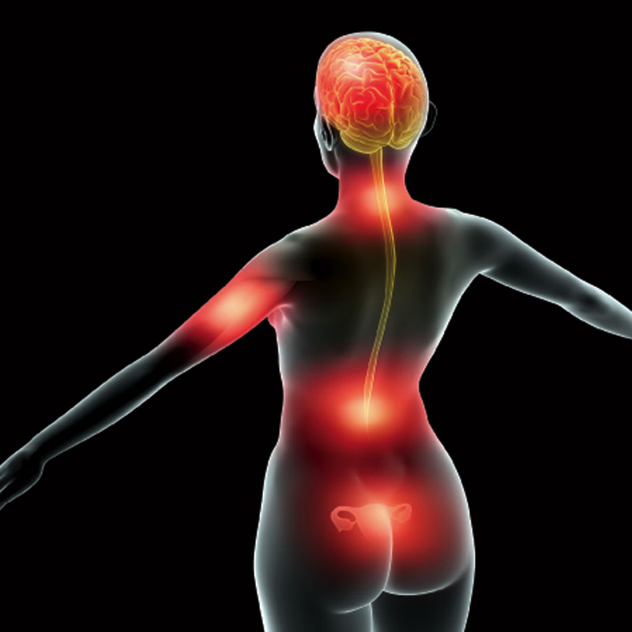
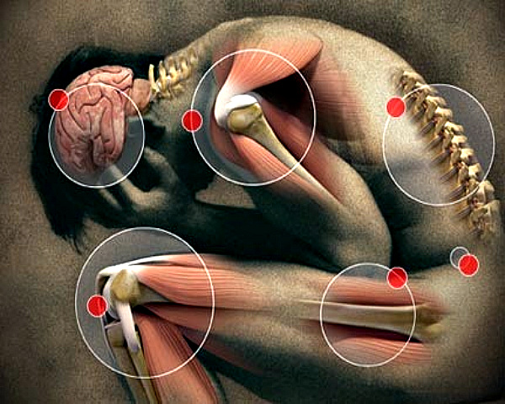
Procjena boli
Povjerenje bolesnika
Sistematični pristup prosudbi boli
Anamneza
Fizikalni pregled
Dijagnostika

Slide 23
Psihosocijalna procjena
Djelovanje boli na bolesnika, obitelj, skrbnike, i druge sudionike
Financijski efekti boli i terapije
Bolesnikov uobičajeni odgovor na bol
Promjene raspoloženja
Uobičajeni načini liječenja boli

Slide 24
Psihosocijalna procjena
Kako bol utječe na vaše fizičko i socijalno funkcioniranje?
Kako bol djeluje na spavanje, aktivnost i raspoloženje?
Značenje boli za bolesnika…
Neverbalna komunikacija.

Slide 25
Psihosocijalna procjena
Učinak i razumijevanje slijeda dijagnoza/terapija na bolesnika i obitelj
Iskustva sa boli u prošlosti i bolesnikova interpretacija
Zabrinutost bolesnikove okoline o korištenju opioida

Slide 26
Postupak procjene boli
Bol treba procjenjivati i dokumentirati:
U pravilnim intervalima nakon početka terapije
Svakom promjenom u razini boli
U prihvatljivim intervalima nakon svake farmakološke i nefarmakološke intervencije
Nastavkom ili promjenom terapije temeljeno na procjenama i th. planu
Joint Commission. Assessment of persons with pain. In: Joint Commission, ed. Pain Assessment and Management: an organizational approach. Oakbrook Terrance, IL: Joint Commission; 2000: 13-25.
Notes:
Pain assessment is an ongoing process.
Patients should be encouraged to report changes in their pain or any new pain so that appropriate reassessment and changes in the treatment plan can be initiated.
Changes in pain patterns or the development of new pain should trigger diagnostic evaluation, and should not be attributed to preexisting causes:
change in pain often indicates advancing disease
new pain often indicates a treatable problem (e.g., infection or fracture)
A comprehensive assessment should be made with each new report of pain and should focus on identifying its cause(s). A pain management plan is formulated with the patient on the basis of the results of this assessment.
Subsequent reassessments should evaluate the plan’s effectiveness. If pain is not relieved, it should be determined whether the type or the dose of analgesic should be changed, whether persistent pain is under control but breakthrough pain persists, whether another pharmacologic or nonpharmacologic approach would be more effective or have fewer side effects, whether the disease is progressing, and whether there is a new pain problem.¹
Reference:
¹Joint Commission. Assessment of persons with pain. In: Joint Commission, ed. Pain Assessment and Management: an organizational approach. Oakbrook Terrance, IL: Joint Commission; 2000: 13-25.

Slide 27
Nefarmakološke intervencije
Fizikalni modus
Fizikalna terapija/Vježbanje
Akupunktura
Psihosocijalni modus
Relaksacija i vizualizacija
Distrakcija
Edukacija
Savjetovanje i grupe za potporu
Hipnoza

Slide 28
Farmakološke intervencije
Acetaminofen
Nesteroidni protuupalni lijekovi (NSAIDs)
Antidepresivi
Antikonvulzivi
Topički anestetici
Opioidi

Slide 29
Lijekovi
Moguće povisivanje doza liojekova do praga tolerancije- NE ovisnosti
Moguće korištenje više vrsta analgetika
Dugodjelujući lijekovi
Kratkodjelujući lijekovi

Slide 30
PLAN
Razvijanje multimodalnog plana liječenja koji uključuje bolesnika→ educirajte bolesnika
Dajte bolesniku osjećaj kontrole u terapiji→ educirajte bolesnika.
Uzmite u obzir financijski status bolesnika kod propisivanja terapije→ educirajte bolesnika.

Slide 31
Procjena boli: Uloga bolesnika
Zauzmite se za sebe!
Ne podliježite mitovima!
Podijelite iskustvo o svojoj boli.
Postavljajte pitanja…

Slide 32
Suzbijanje boli i drugih simptoma u izravnoj su vezi s kvalitetom života bolesnika.
Bolesnici najteže podnose bol.

Slide 33
Pitanja?
Komentari?

Slide 34
Izvorni slajdovi: Mato Devčić

